Slide 1
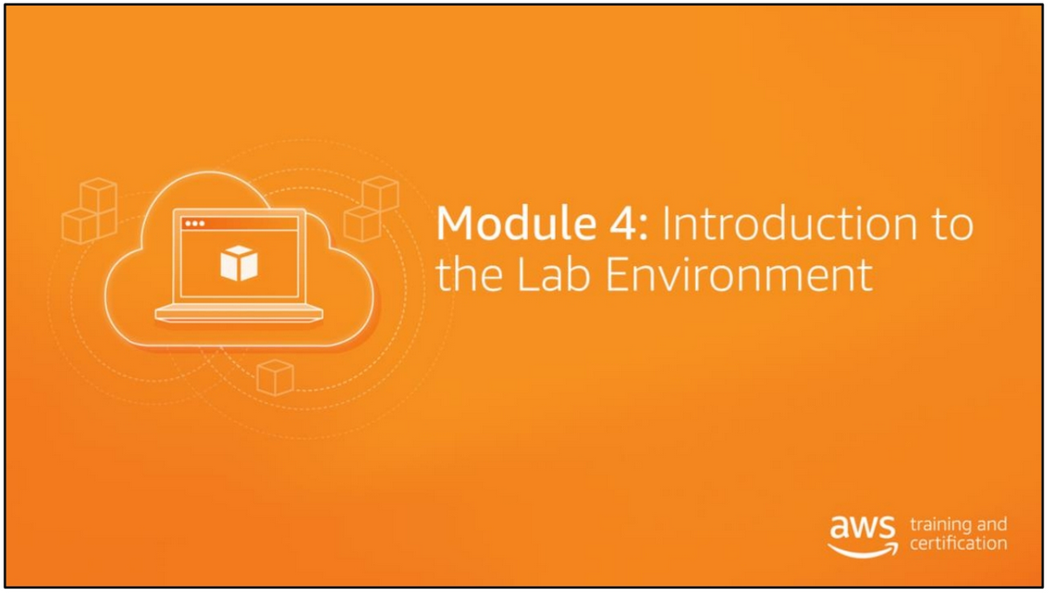

Slide 2
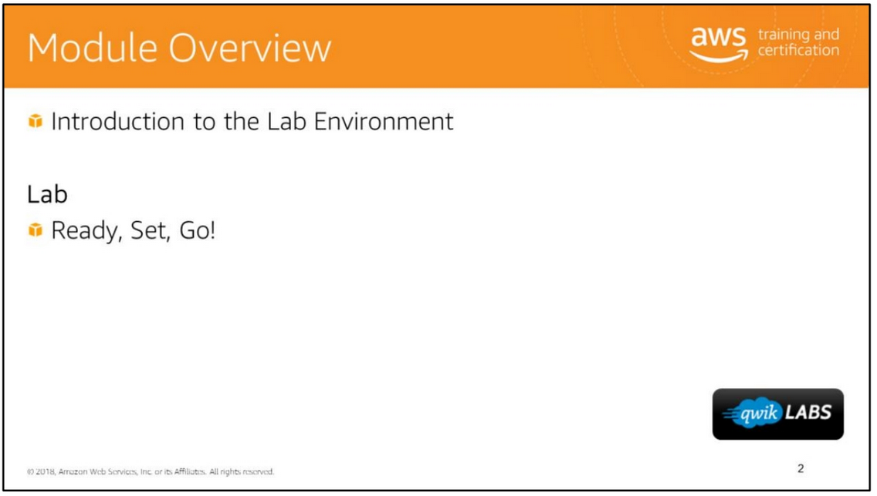

Slide 3
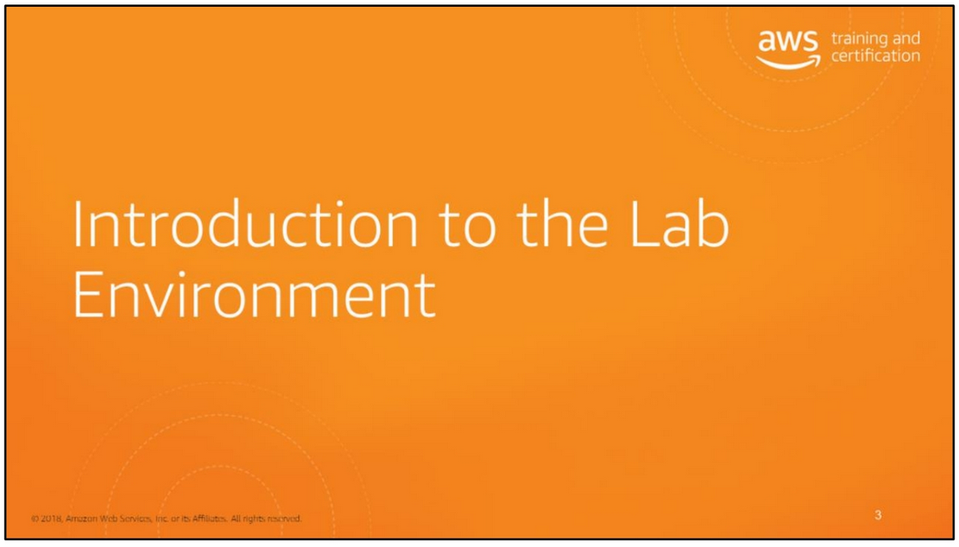

Slide 4
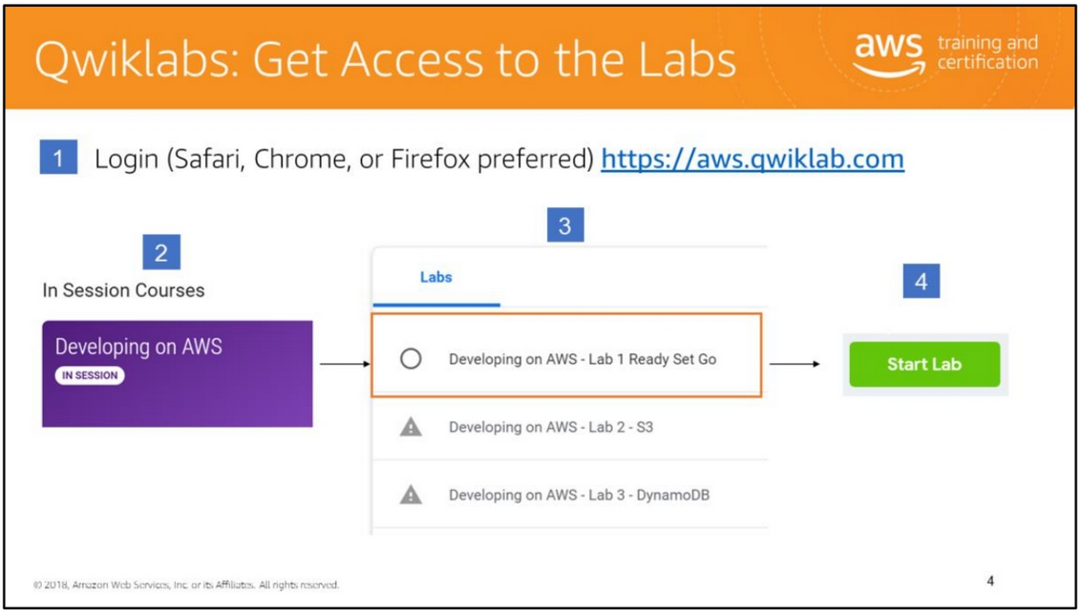
To login to your lab environment, see https://aws.qwiklab.com.
When your instructor indicates that a hands-on lab is available, access Qwiklabs. The first time you use the Qwiklabs Single Sign On you need to link your Qwiklabs account. If you do not have an account, we can initiate the creation process. You need to acknowledge the link between AWS Training and Qwiklabs accounts.

Slide 5
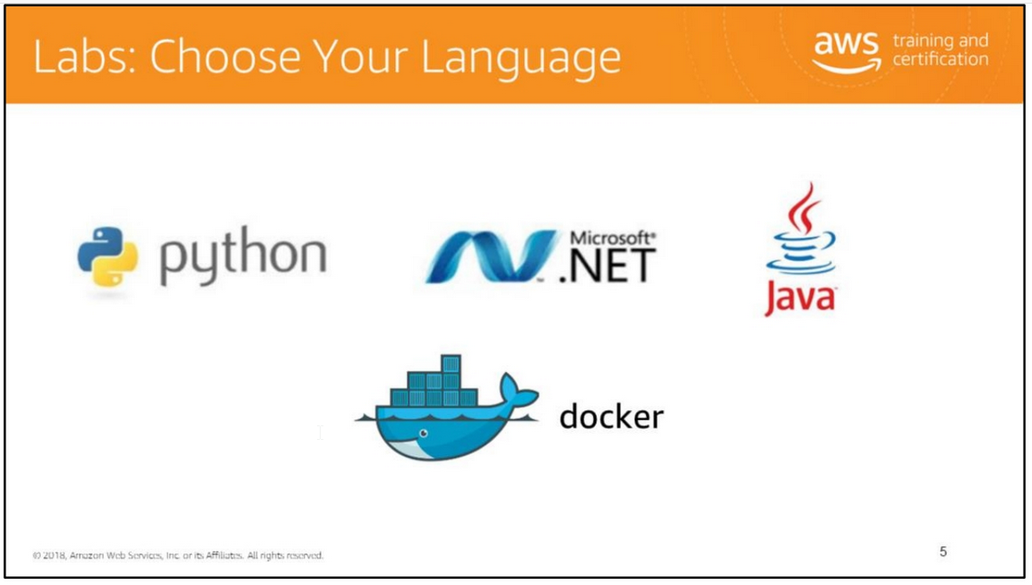
The reason that Docker is on the slide is due to one lab done entirely in Docker.

Slide 6
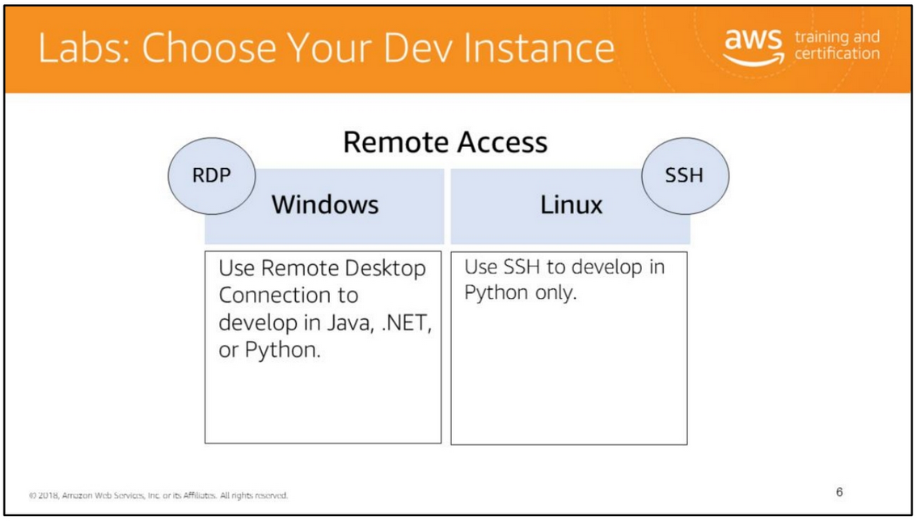
The Qwiklabs environment has been set up with all the SDKs and development tools needed for you to dive straight into the actual code to develop your application.
Amazon EC2 uses public–key cryptography to encrypt and decrypt login information. Public–key cryptography uses a public key to encrypt a piece of data, such as a password, then the recipient uses the private key to decrypt the data. The public and private keys are known as a key pair.
To log in to your instance, you must create a key pair, specify the name of the key pair when you launch the instance, and provide the private key when you connect to the instance. Linux instances have no password, and you use a key pair to log in using SSH. With Windows instances, you use a key pair to obtain the administrator password and then log in using RDP. Amazon EC2 Key Pairs: http://docs.aws.amazon.com/AWSEC2/latest/UserGuide/ec2-key-pairs.html.

Slide 7
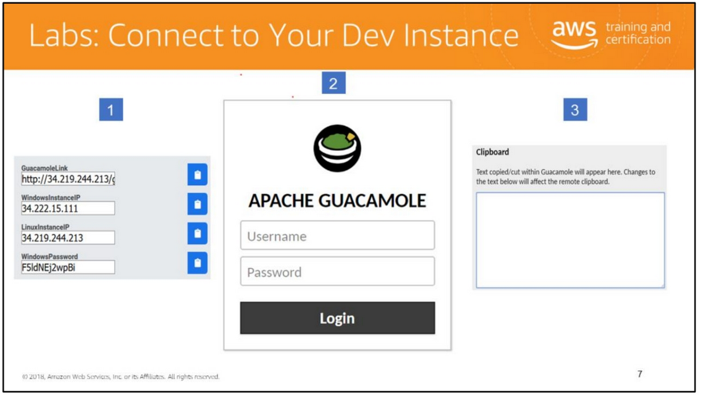

Slide 8
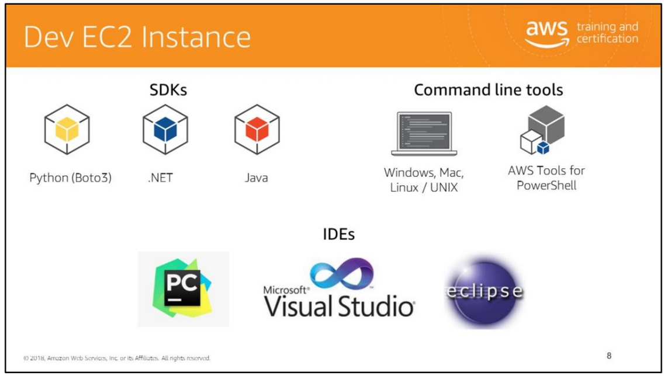

Slide 9
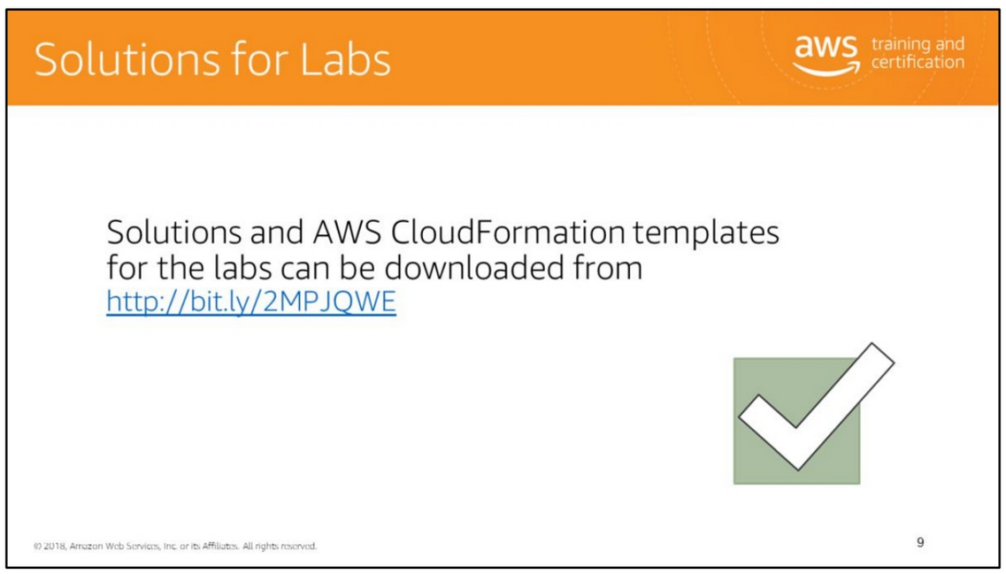
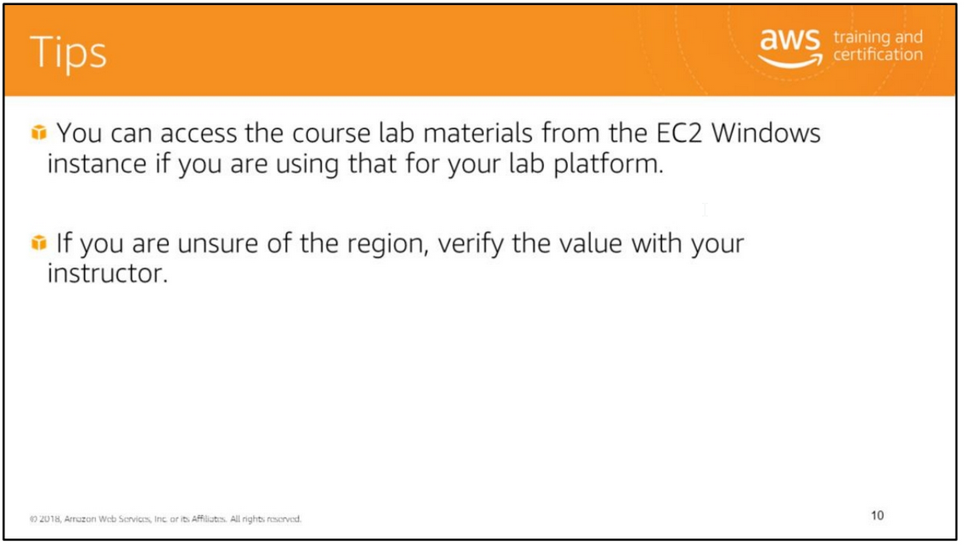
Solutions and AWS CloudFormation templates for the labs can be downloaded from http://bit.ly/2MPJQWE .

Slide 10
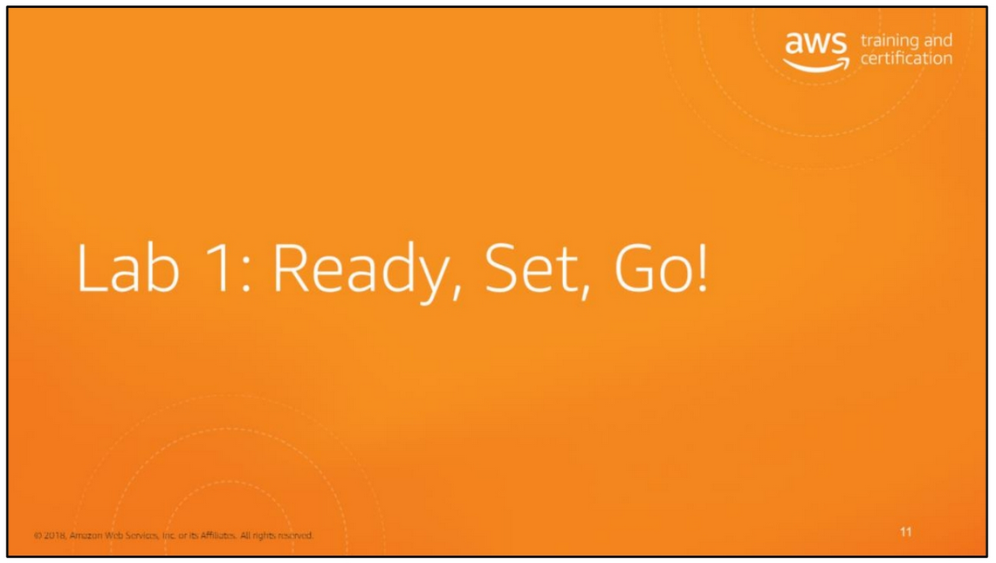

Slide 11
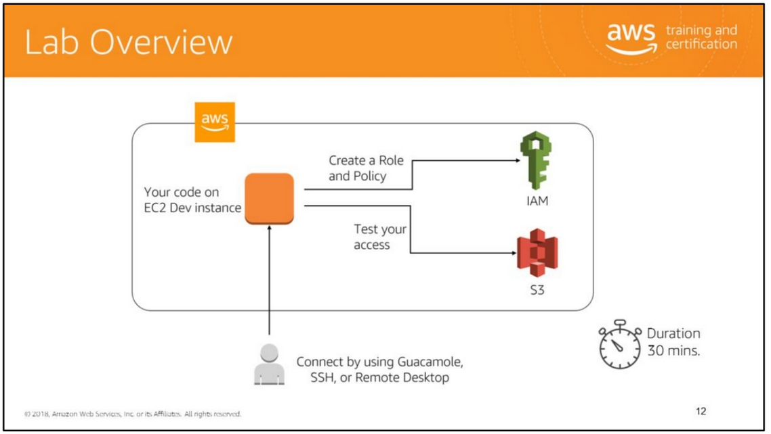
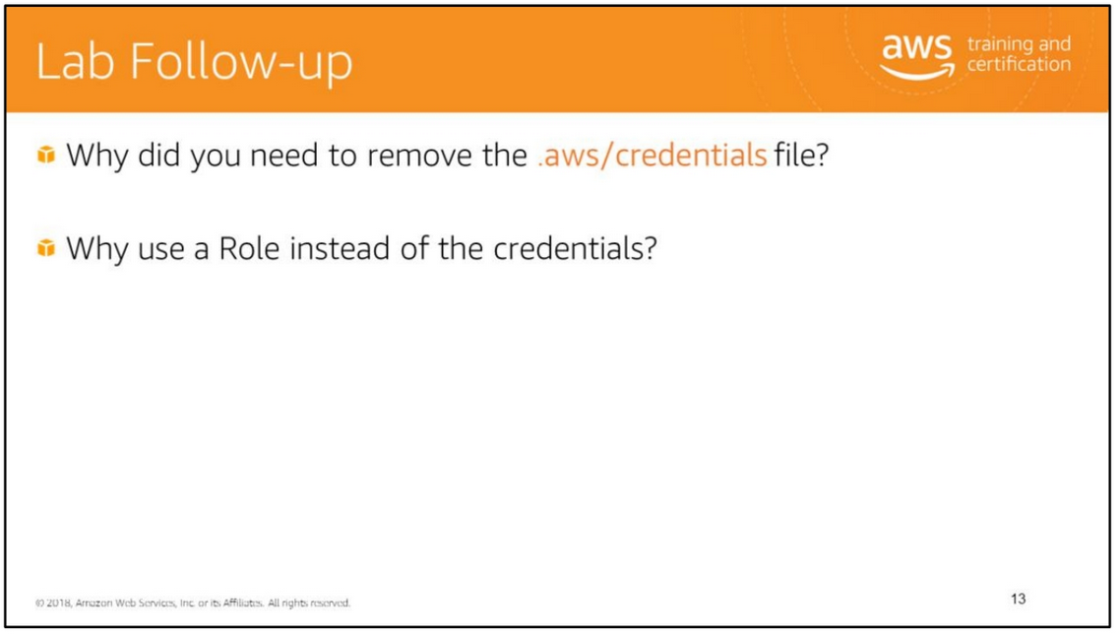
In the lab, you will:
• Set up your AWS developer credentials.
• Describe key aspects related to using the AWS SDK.
• Create an IAM Policy.
• Create an IAM Role.
• Assign a Policy to a Role.

Slide 12
